Slide 1
iosh.com

Slide 2
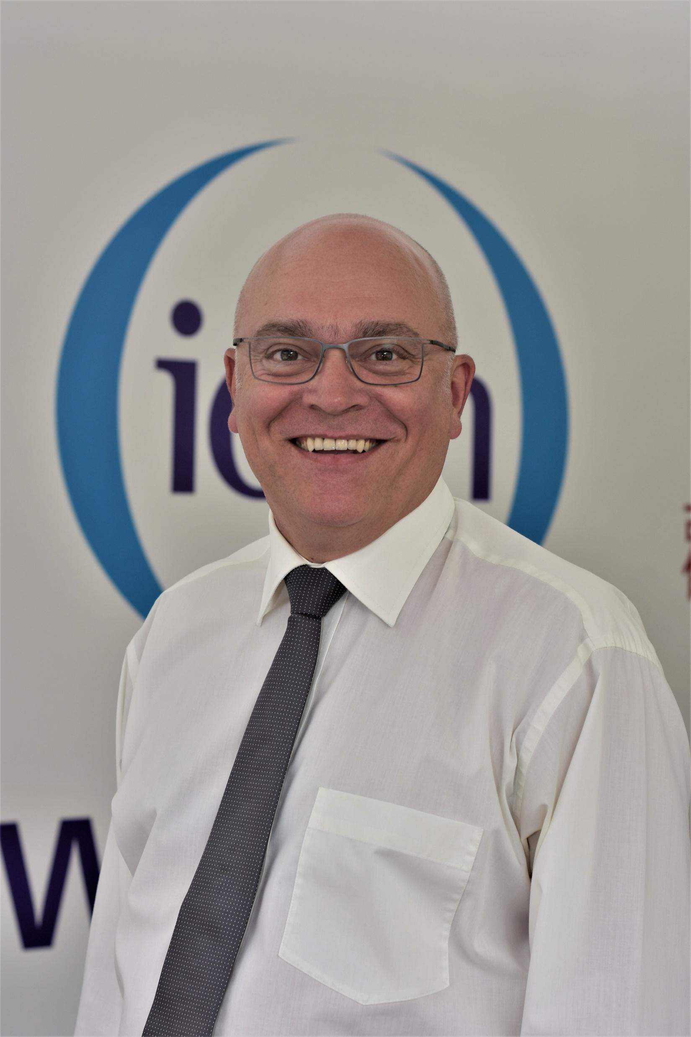
Alan Stevens
Head of Strategic Engagement
iosh.com

Slide 3
Introducing IOSH
50,000+ members
130 countries
2,300+ student members
907,000+ trained on IOSH courses

Slide 4
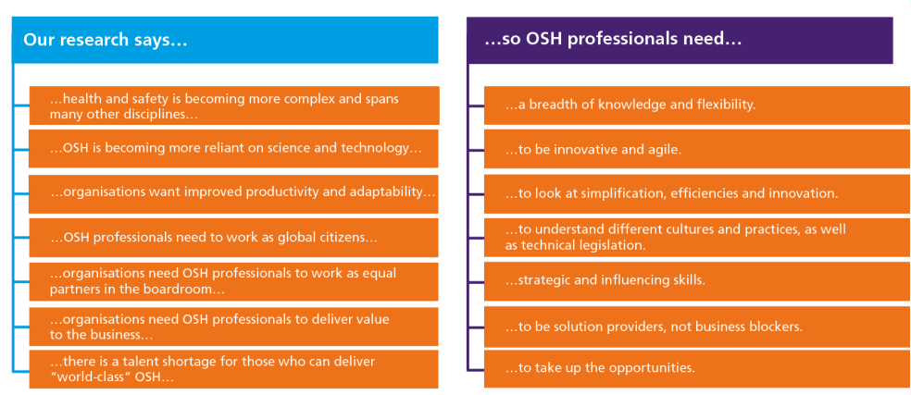
The Future of OSH professionals

Slide 5
Competency Framework
69 Competencies
12 Areas
Across Technical, Core and Behavioural categories
Notes:
Technical competencies
Apply to certain roles or a family group within the organisation. These competencies outline any technical expertise required and assess the depth and breadth of that skill and knowledge.
Core Competencies
Support the organisations values and mission. Usually apply to all jobs in the organisation and include leadership and management.
Behavioural competencies
Soft skills that reflect personal behaviours and attributes
69 competencies divided into 12 areas across technical, core and behavioural categories.
The framework covers all the skills, knowledge and behaviours needed by occupational safety and health professionals.
Technical Competencies- 5 areas across this competency area-
These competencies include understanding legislation, policy, risk management, incident management and the effect of safety and welfare on people. Also includes new technical competencies such as sustainability, ethical practice, human capital and community impact

Slide 6
Competency Levels
Level 1- New / Aspiring
Level 2- Ambitious
Level 3- Experienced
Level 4- Established Leader
Notes:
Level 1- New / Aspiring – UNDERSTAND Aspiring future OSH professionals.
Tend to be either students or embarking on their OSH career
Level 2- Ambitious Network- IMPLEMENT
Ambitious OSH professionals looking to progress their membership level, expand their knowledge and stay up to date on new developments within health and safety, and looking to develop wider skill sets. Tend to be teaching/training others.
Level 3- Experienced Manager- LEAD (certified member)
OSH practitioners who have a wealth of career experience. May well be in senior roles where OSH is only one part of their role
Level 4- Established Leader – INNOVATE (chartered member)
More established and experienced OSH leaders who tend to be older, Chartered members who are more interested in engaging in debate and shaping the profession rather than own development. Confident and are proud of the profession.

Slide 7
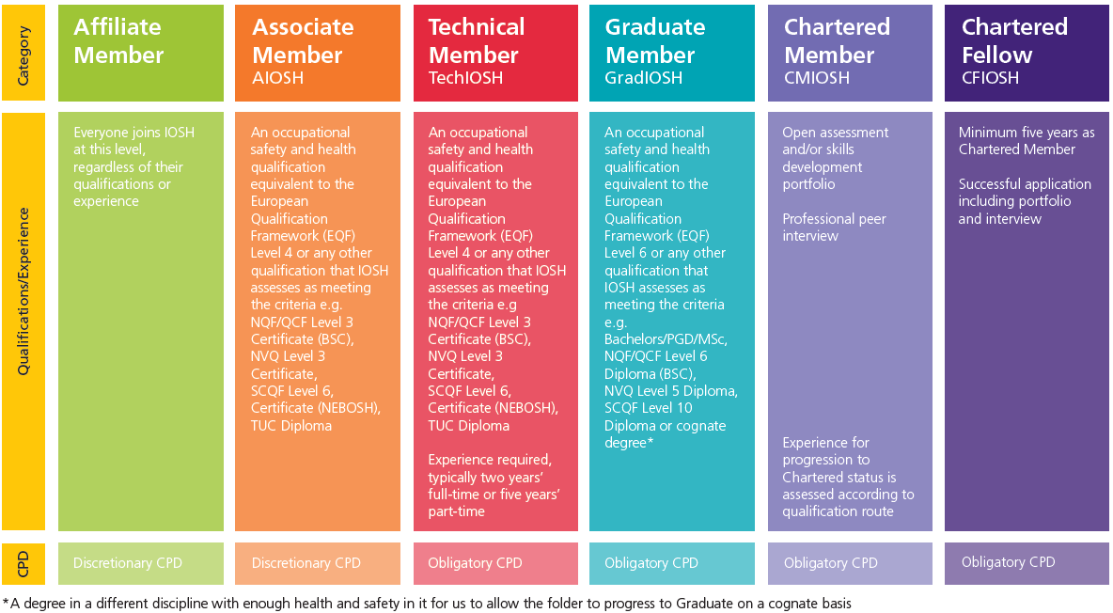
IOSH Membership

Slide 8
Thank you Alan.Stevens@IOSH.com
iosh.com

