Slide 1
Lessons from Corporate: Developing Safety Culture
Mike Goddu, Co-Founder and Managing Director 25 May 2023
© JMJ

Slide 2
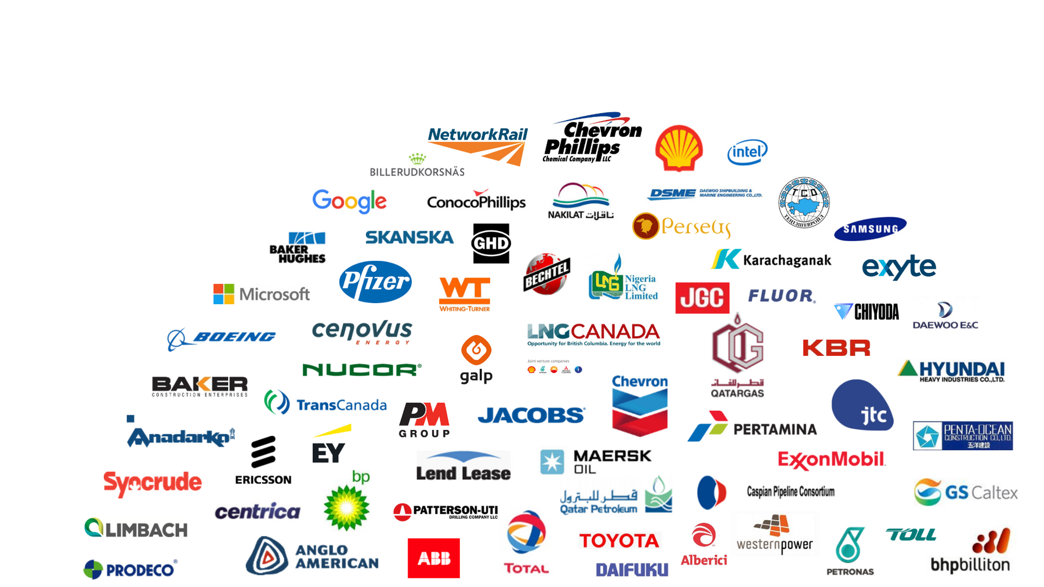
JMJ Kazakhstan: Local presence, global reach
25+
years of experience in Kazakhstan
Offices and consulting teams across Kazakhstan

Slide 3
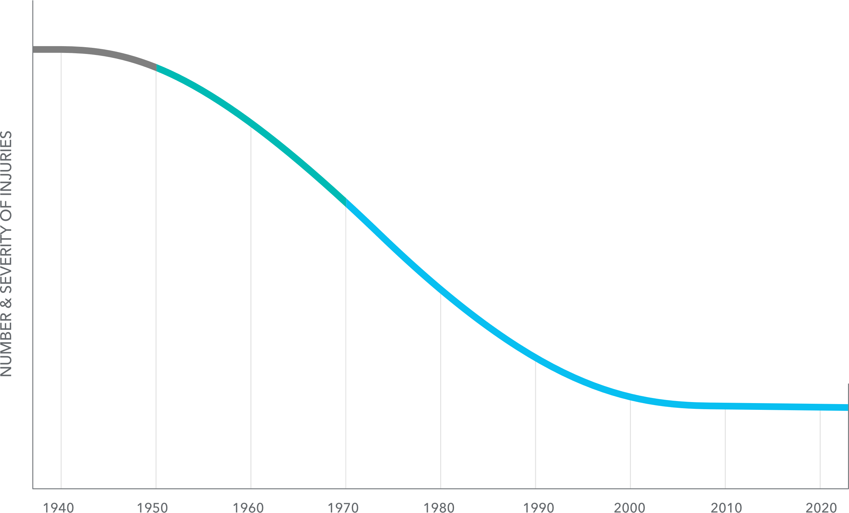
Evolution of Safety Management
© JMJ
3
TM and © JMJ Associates

Slide 4
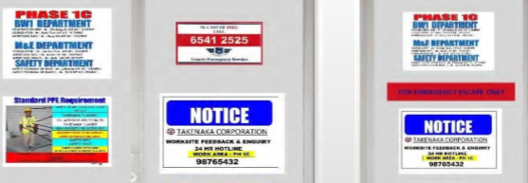
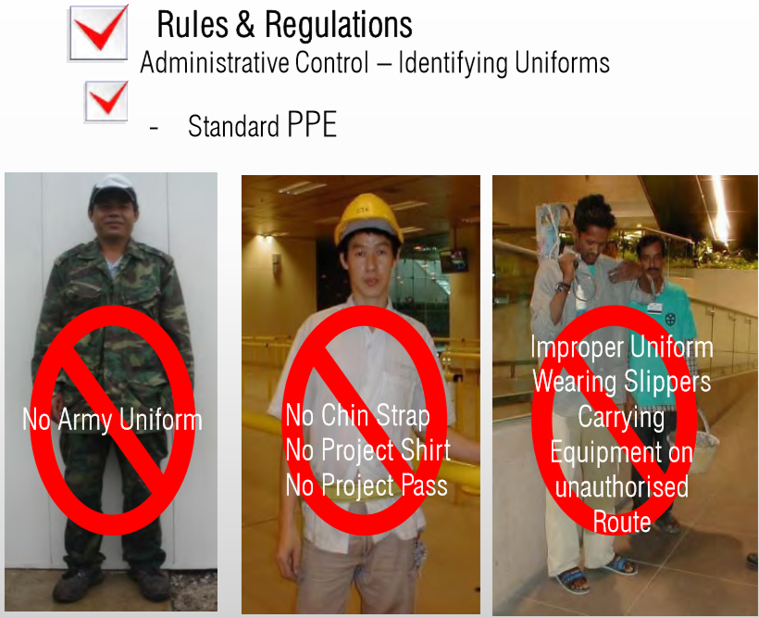
Lots of rules and penalties; compliance is the “best we can get”
Inductions are stale, formal, then forgotten…
Workers don’t understand the hazards…
Safety is regulatory, punitive, difficult to understand and “can only get me in trouble.”
Notes:
1 min 20
Typical Safety Training: Rules, Fines
What are workers learning? Safety can only get me in trouble!! Disengagement!!

Slide 5
Causing a shift

Slide 6
What shifted?
FROM… | TO…
348 to 70 | Zero!
Numbers | People
Compliance – Penalties | Intrinsic Motivation
Sincerity | Commitment!
“Have to” | “Want to”!
A successful culture program makes safety personal and meaningful for everyone in the organization.

Slide 7
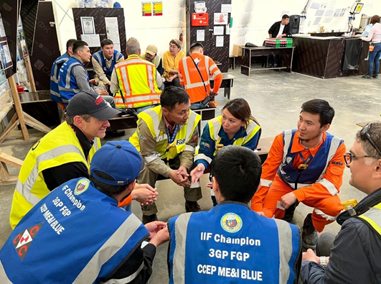
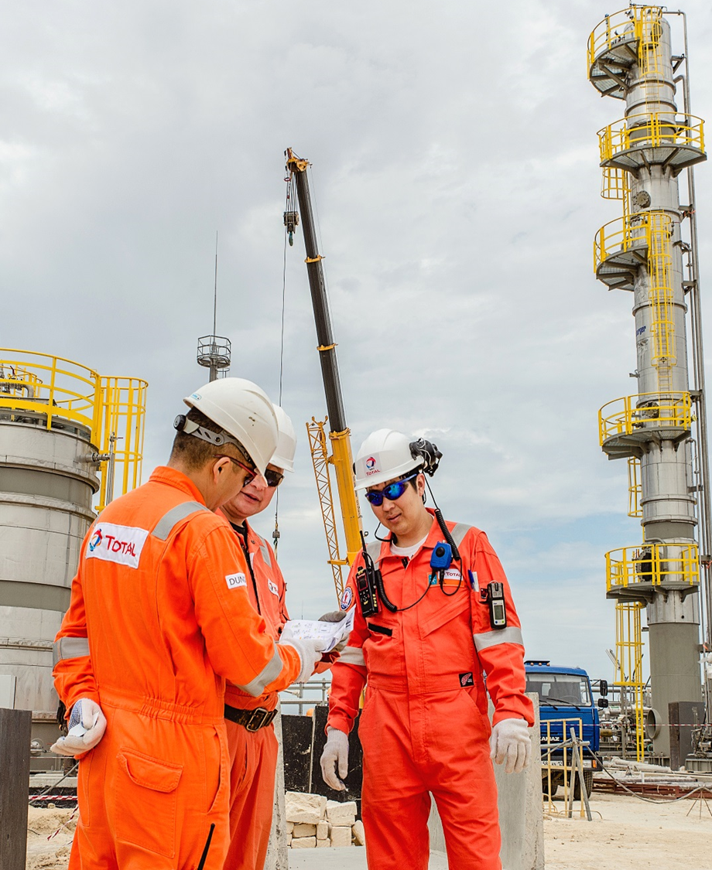
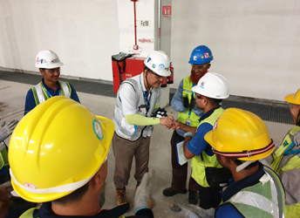
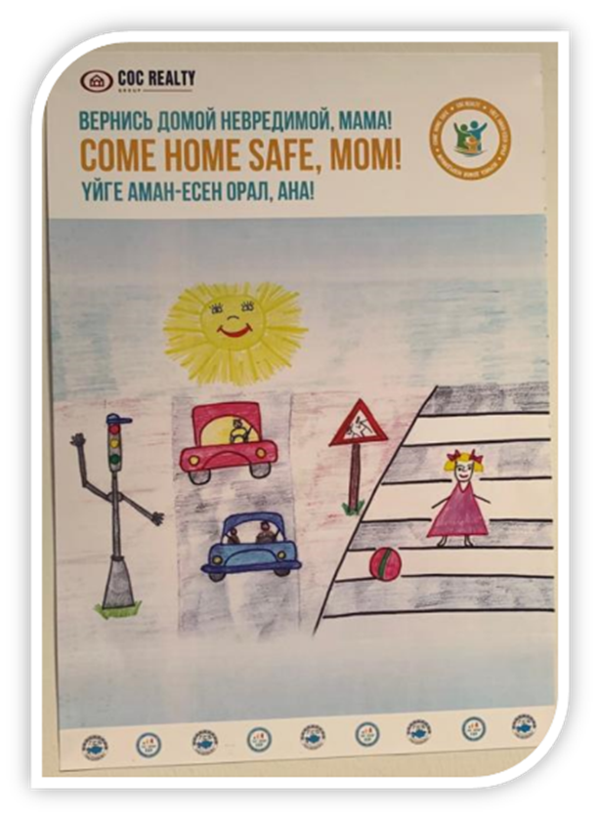
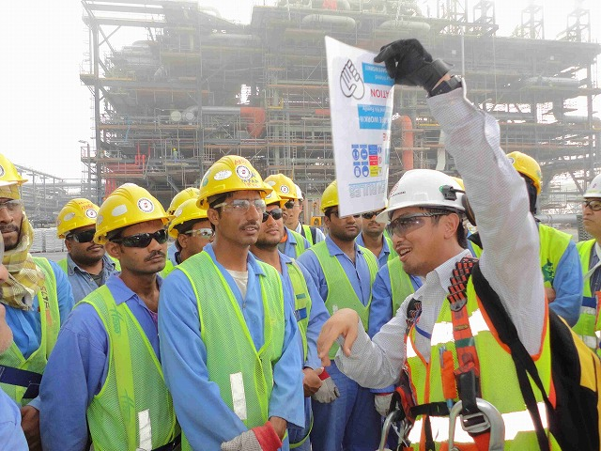
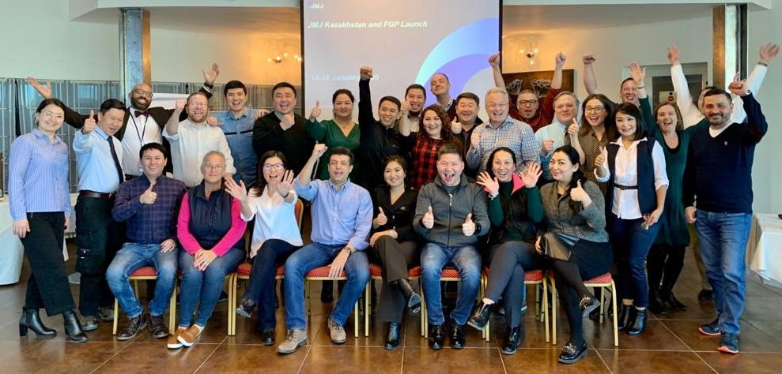
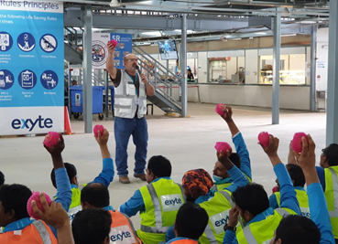
7

Slide 8
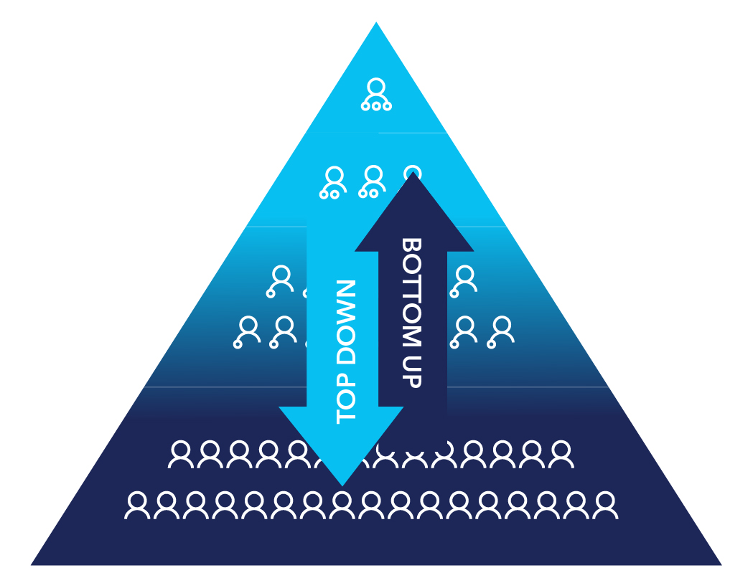
Changing Culture: Leading & Sustaining Change
Executives demonstrating their leadership, ting high expectations for the health and safety of our people and performance.
Senior management visibly leading a culture of care and of operational excellence.
Mid-management and supervision learning and practicing the people skills that result in extraordinary teamwork and performance
Workforce confident to speak up, intervene, engaged and empowered to improve safety and operations.
8

Slide 9
Никогда не сомневайтесь в том, что небольшая группа вдумчивых, приверженных людей может изменить мир. В действительности, это единственное, что может это сделать.
- Маргарет Мид
Never doubt that a small group of thoughtful, committed people can change the world. Indeed, it is the only thing that ever has." -Margaret Mead
Thank you
© JMJ
Благодарим за внимание

